Slide 1

Advances in Valley Vegetable Production and Irrigation
Juan Enciso, P.E. Ph.D.
Catherine Simpson, Ph.D.
Carlos Avila, Ph.D.
Sheren Elsayed Farag, Ph.D.
March, 2018
Texas AgriLife Research and Extension Center , Weslaco

Slide 2
Tomato Production in the Lower Rio Grande Valley
Spring Season
Fall Season
June 20
Harvest
Planting
March 31
June 14
Planting
March 15
June 9
Planting
September 19
Jan 17
May 30
Dec 21
June 14
Jan 17
Planting
Feb 29
May 19
Planting
Sep 6
Dec 21
Jan
Feb
Mar
Ap
May
Jun
Jul
Aug
Sep
Oct
Nov
Dec
Jan
Feb

Slide 3

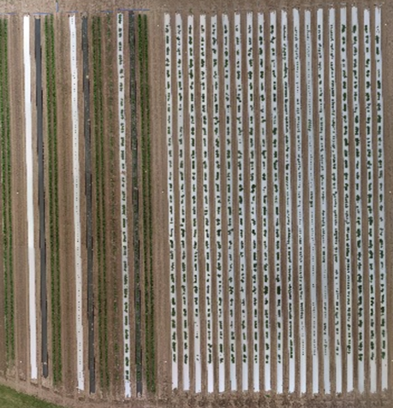
1st planting
2nd planting
3rd planting
Experimental Design
3 treatments; (black plastic, white plastic and bare)
3 Planting dates
4 Plants/plot (variety)
80 inches beds
Plant spacing 8 inches
Planting dates:
1st - 2/28/16
2nd - 3/15/16
3rd - 3/31/16

Slide 4
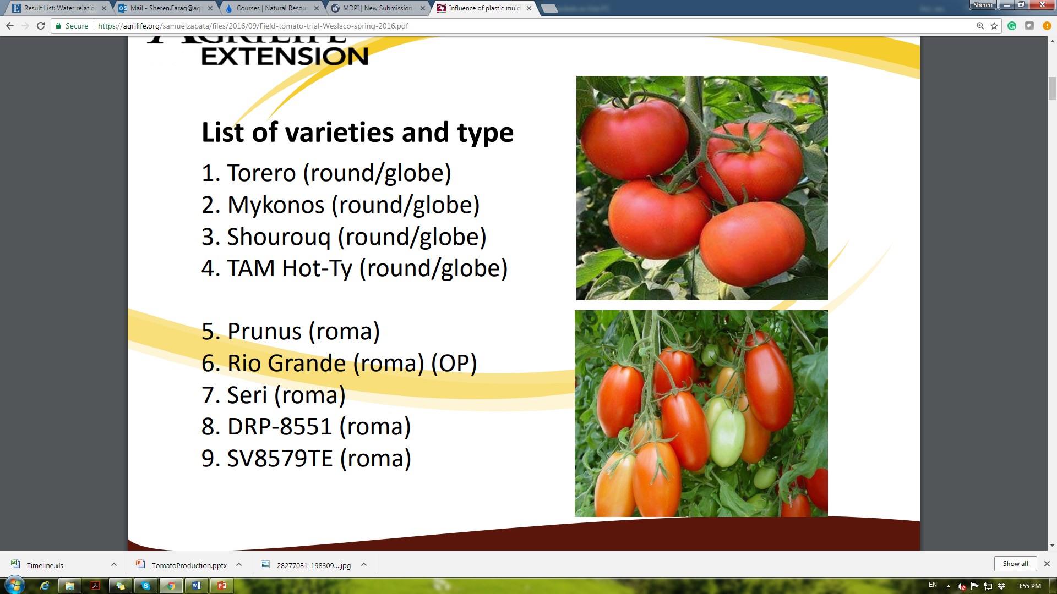
List of varieties and type
1. Torero (round/globe)
2. Mykonos (round/globe)
3. Shourouq (round/globe)
4. TAM Hot-Ty (round/globe)
5. Prunus (roma)
6. Rio Grande (roma) (OP)
7. Seri (roma)
8. DRP-8551 (roma)
9. SV8579TE (roma)

Slide 5
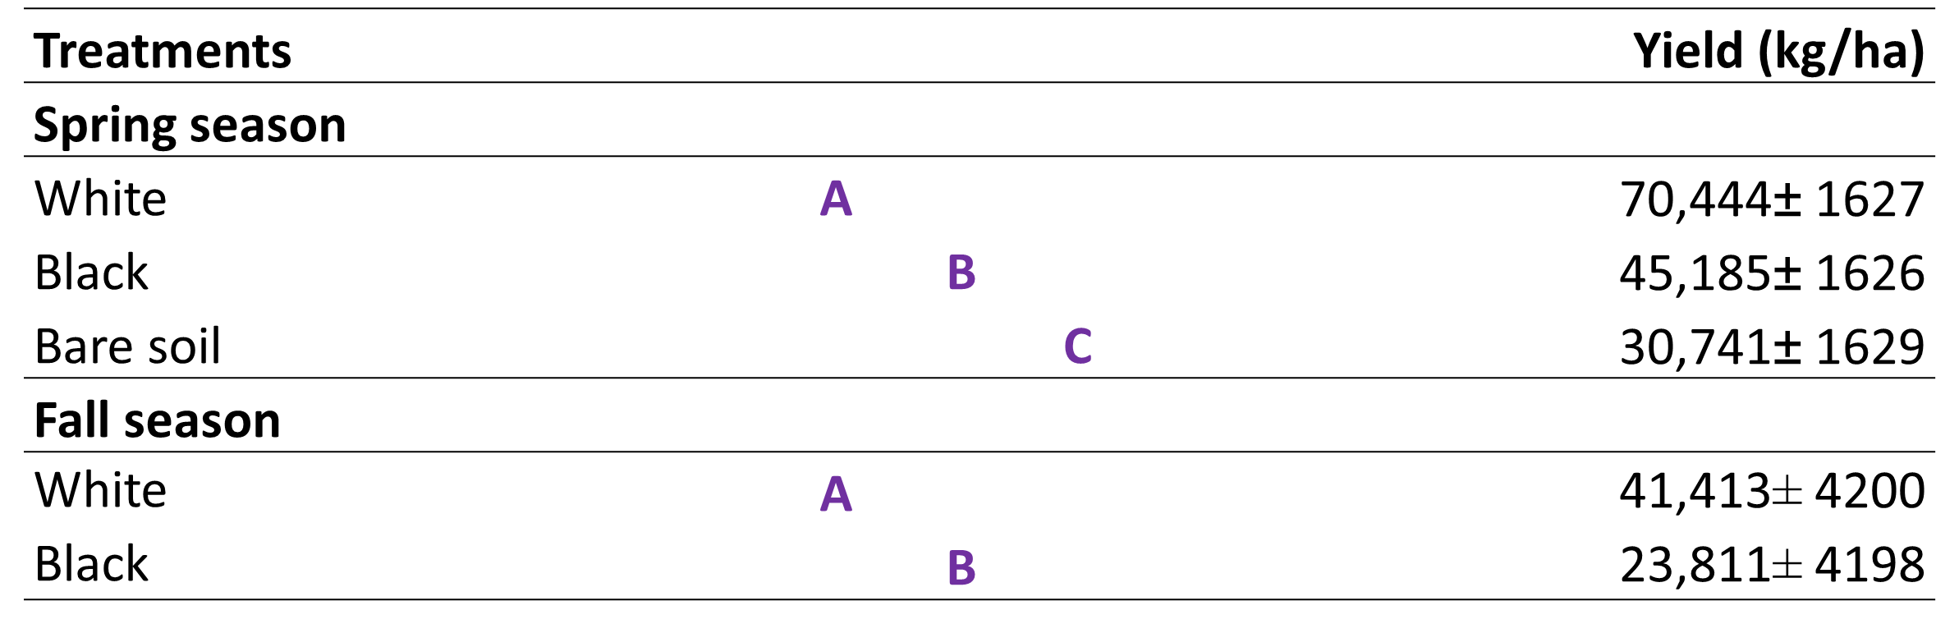
Results
The white plastic resulted in a higher average yield (for all the planting dates and tomato varieties). Similar results were observed in the fall season

Slide 6
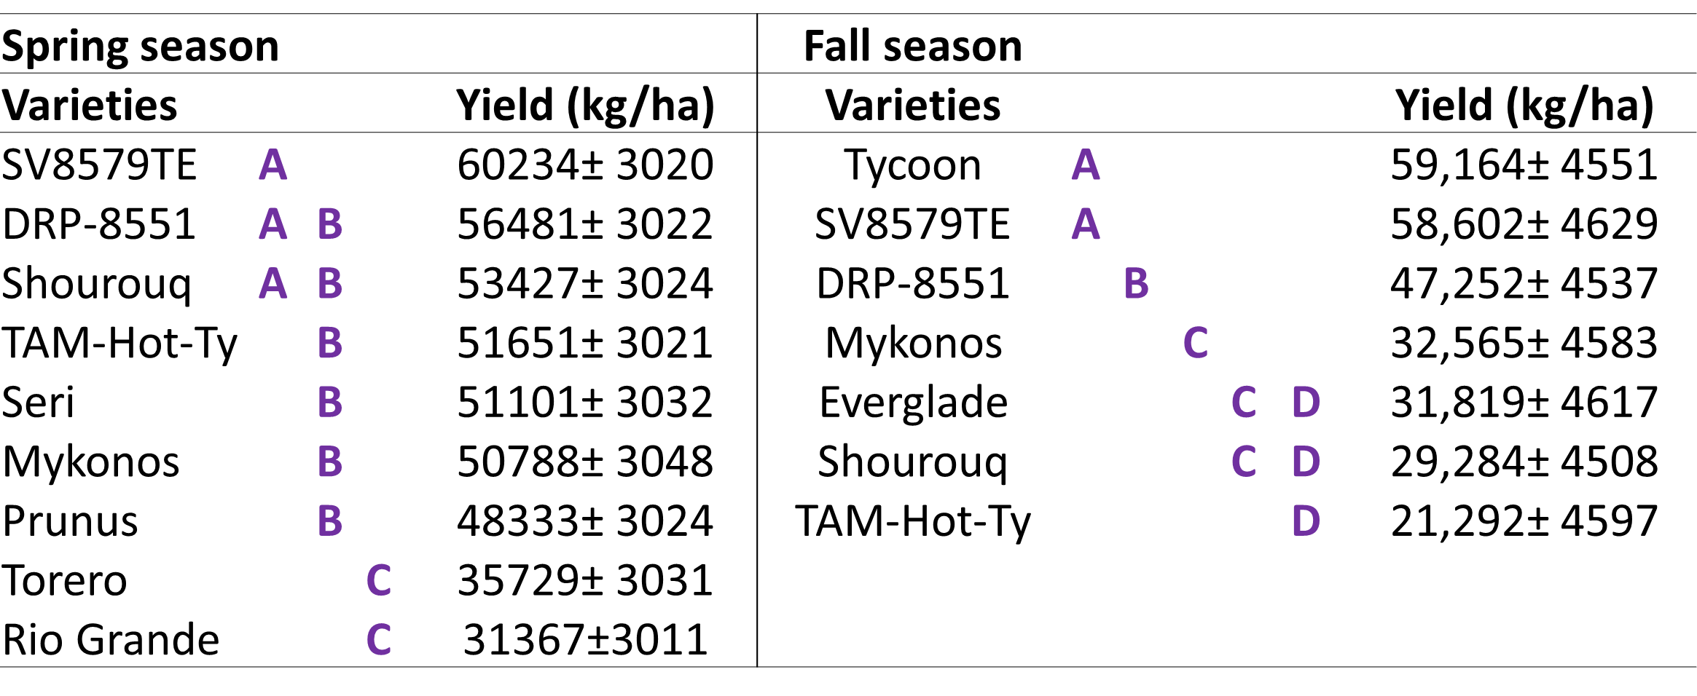
Results
A significant difference was observed among the tomato varieties in both seasons (P=<.0001).

Slide 7
TOMATO PRODUCTION ON NET HOUSES
Control high temperatures
Reduce wind damage
Reduce insect pressure and diseases
Lower white fly incidence
60% higher yields on Spring
Higher sugar content and acidity (components of flavor)
180% Higher yields on Fall
Economically feasible

Slide 8
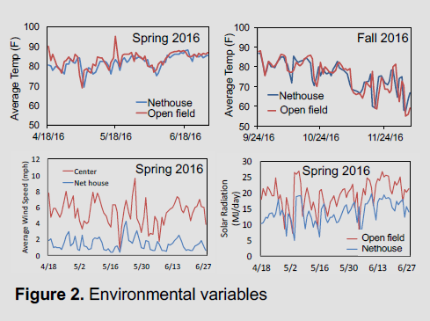
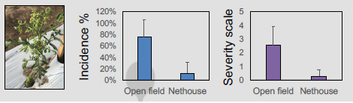
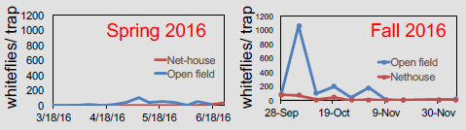
TOMATO PRODUCTION ON NET HOUSES
Tomato Leaf Curl Virus Disease
White Fly population
Environmental Variables

Slide 9
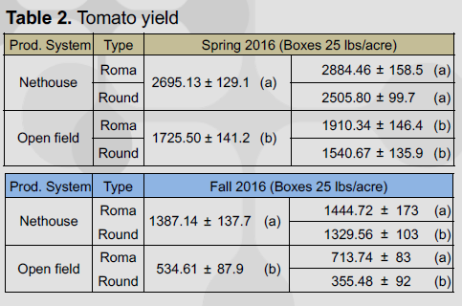
TOMATO PRODUCTION ON NET HOUSES
Spring: 60% higher yields
Fall: 180% Higher yields
Economically feasible

Slide 10
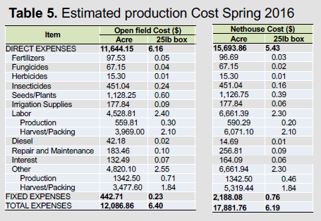
TOMATO PRODUCTION ON NET HOUSES
$266 to $289 per 1000 sqft
Harvesting and Packing account of 62% of the total cost.
Direct Production costs 34.7%
Fixed cost 3.7%

Slide 11
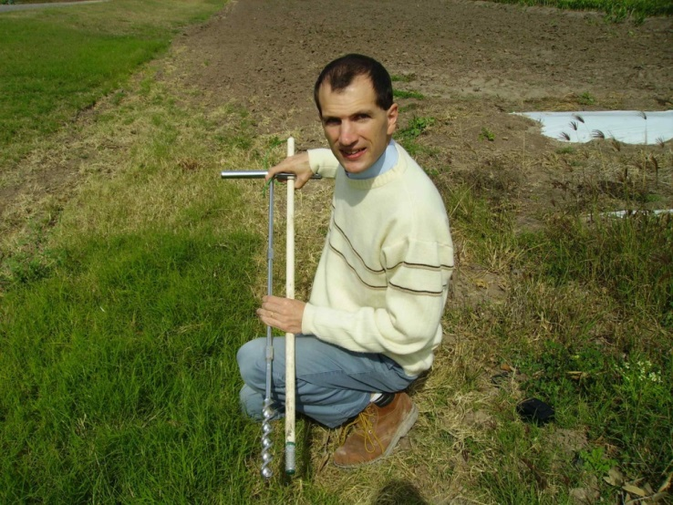
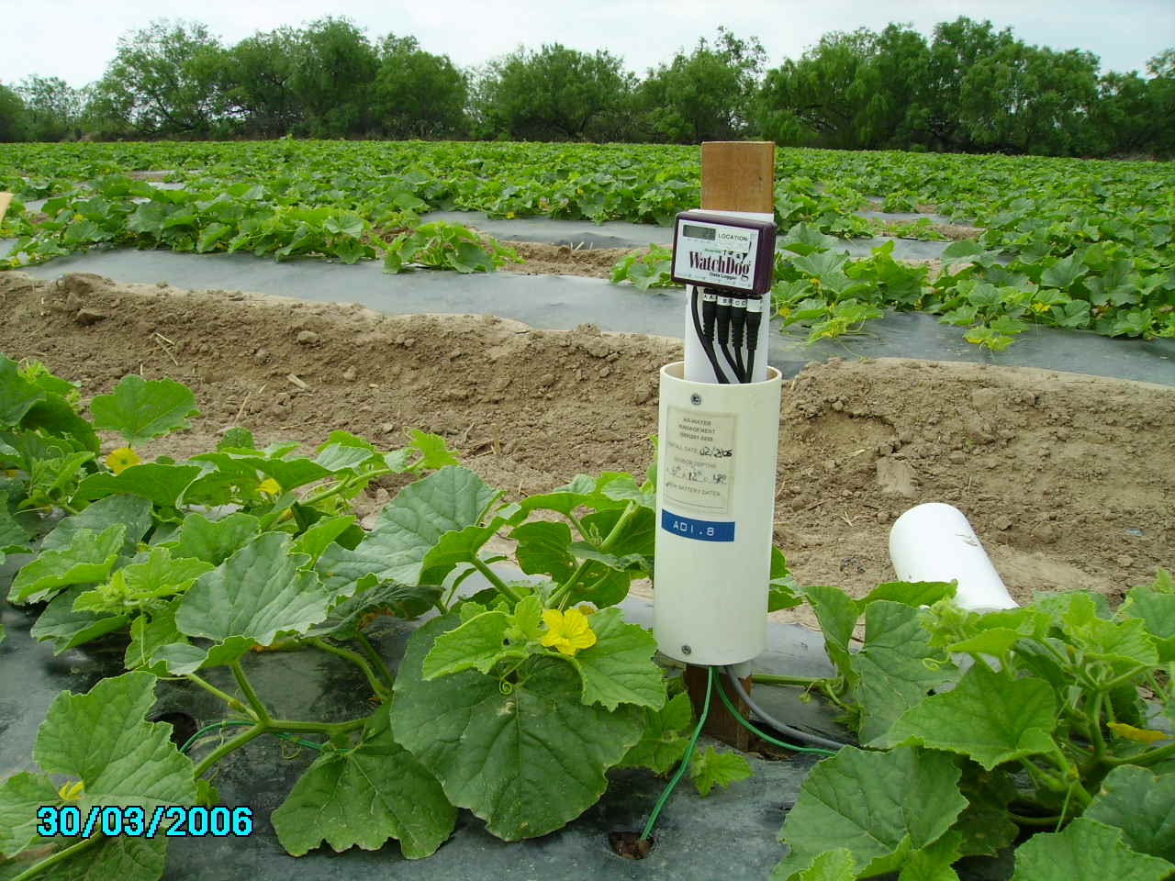
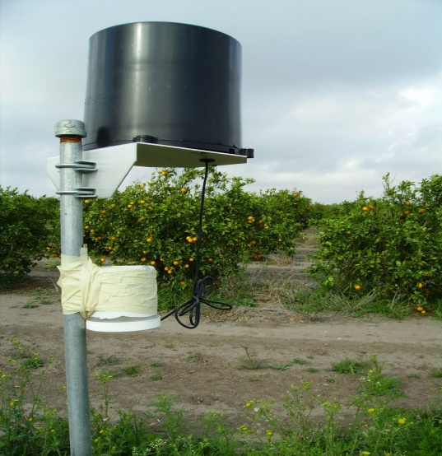
Open Field: irrigation monitoring
Probe $35
Datalogger: $300 each
Rain gauge $150
Software: $250

Slide 12
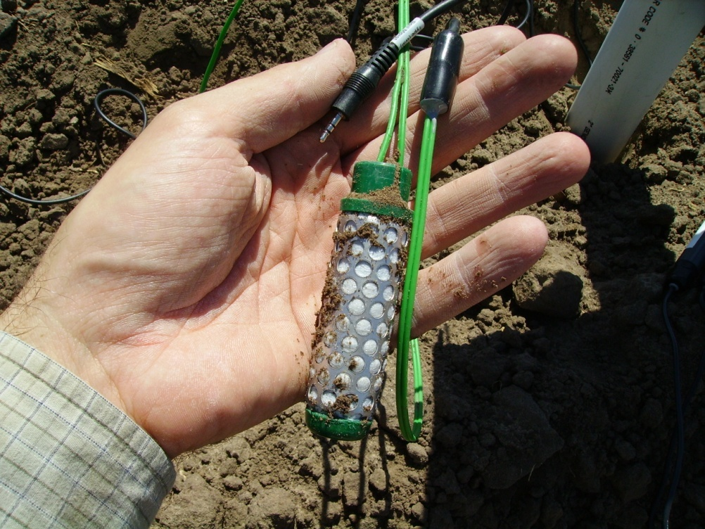
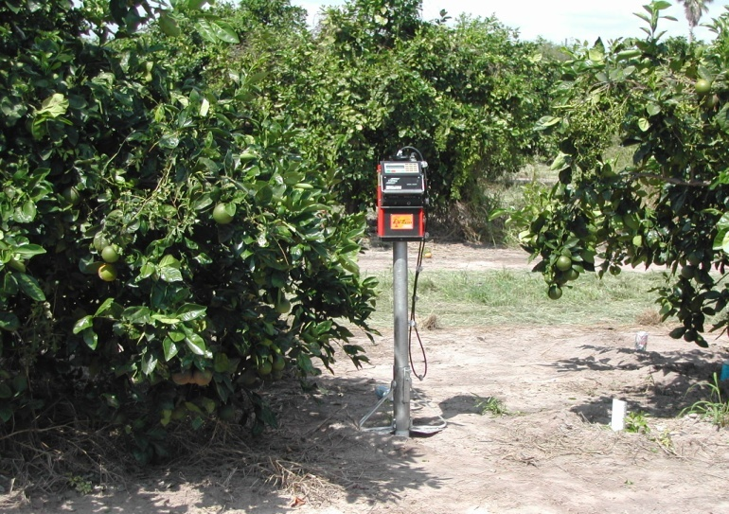
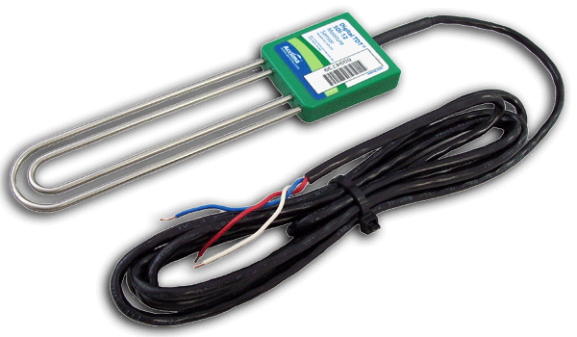
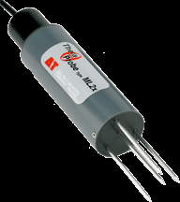
What seems to work well
Neutron gauge
Watermark
Acclima sensor
ThetaProbe

Slide 13
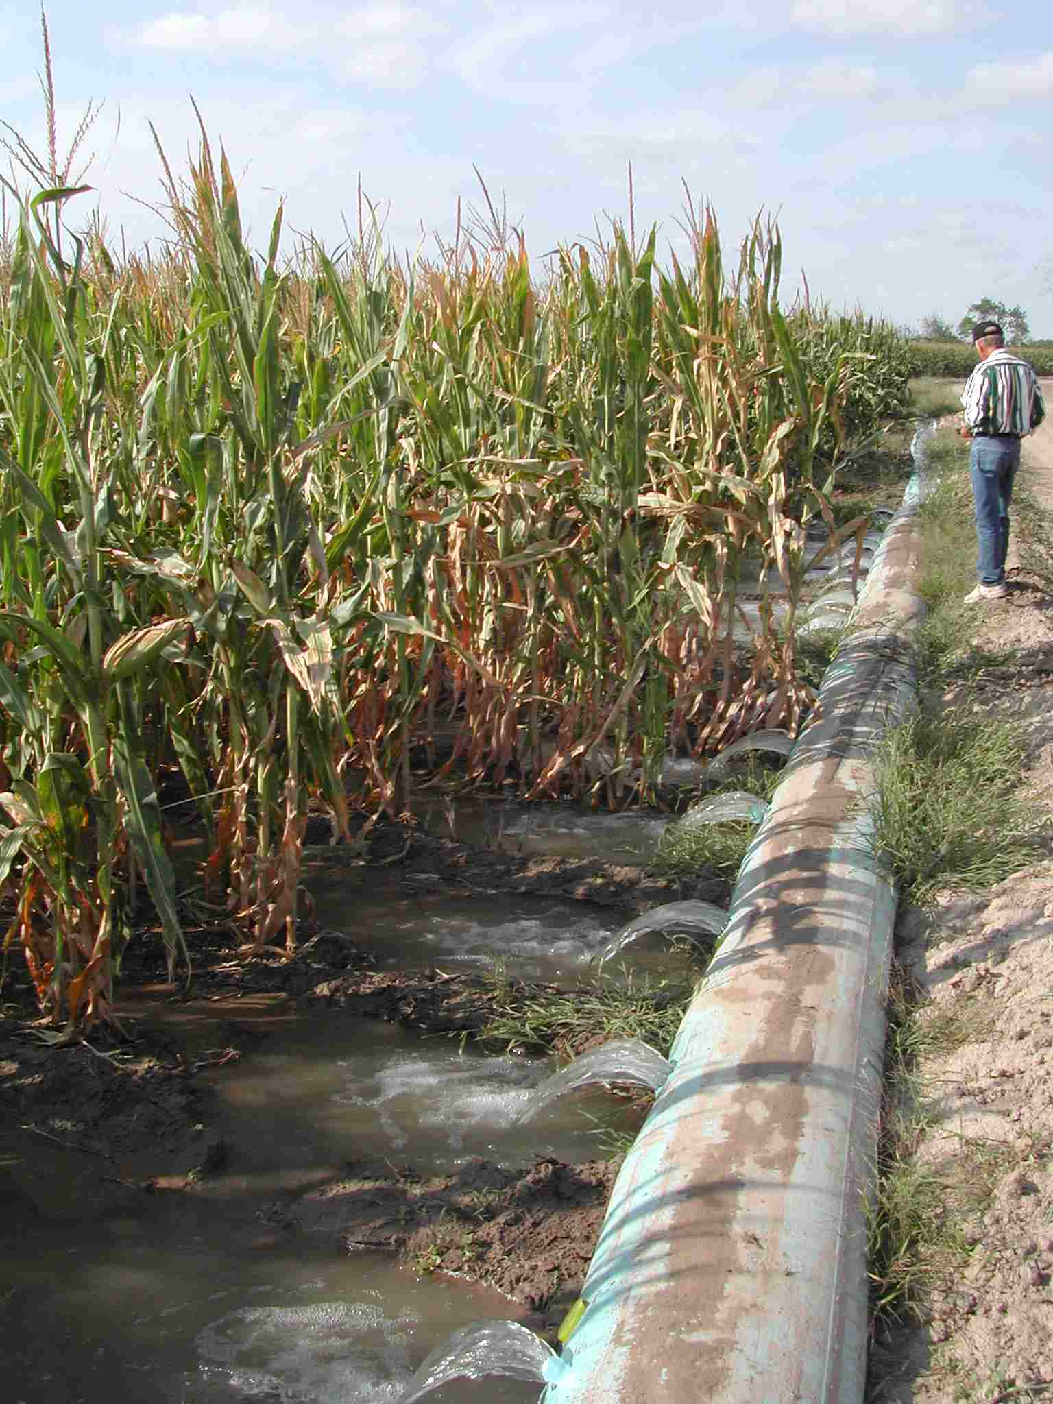
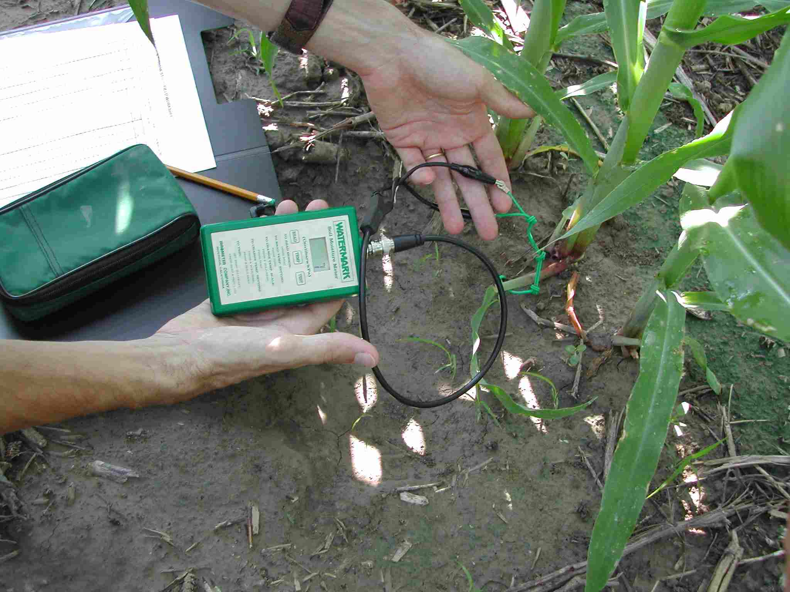
Placement depth and read threshold
In vegetables with water mark sensors
installed at 12 inches trigger irrigation at
30 cb

Slide 14
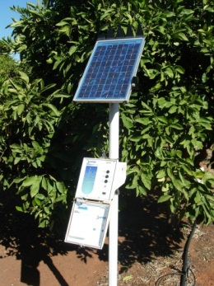
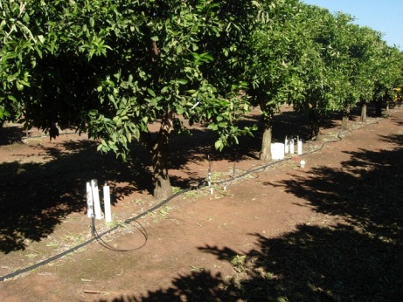
Measurements in soil the soil as volumetric soil water content can be estimated using soil water sensors.
In vegetables with water mark sensors
installed at 12 inches trigger irrigation at 30 cb, in citrus 60 cb

Slide 15
Monitoring soil water in vegetables
8
Available
Water
Moisture content
4
Soil moisture (in)
25% AW
2
June
July
Aug
Aug

Slide 16
Irrigation Program
To develop an internet computer based program website http://southtexasweather.tamu.edu
For farmers in Texas to provide users daily and hourly weather data and calculate crop evapotranspiration for sugarcane, citrus, corn, cotton, onions, sudan grass and watermelons for full irrigation.

Slide 17
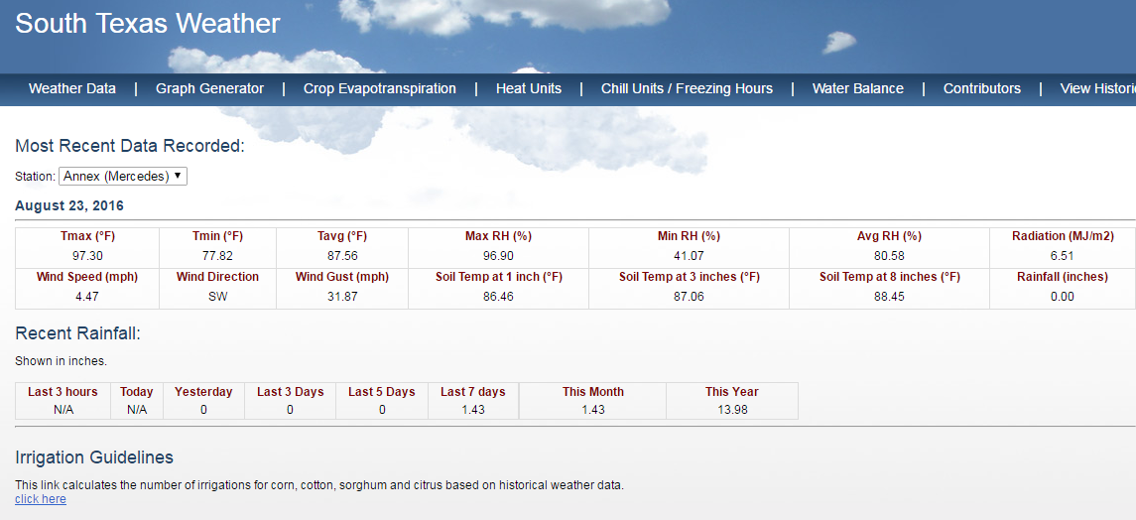
Weather Data
Internet website:
http://southtexasweather.tamu.edu/

Slide 18
Features of the program
Six weather stations located in the Lower Rio Grande Valley, Markham and Pecos, TX.
Water Balance to calculate the number of irrigations and water amount needed in a growing season.
Heat and Chilling Units can be calculated using hourly data.
A decade’s worth of data available for download.
The program was used to develop irrigation guidelines for the main crops including the number of irrigations required according to soil type, root depth.

Slide 19
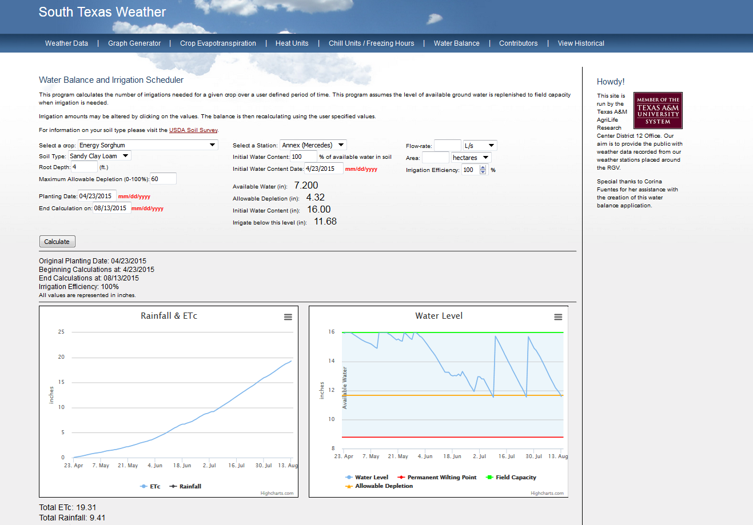
Water Balance

Slide 20
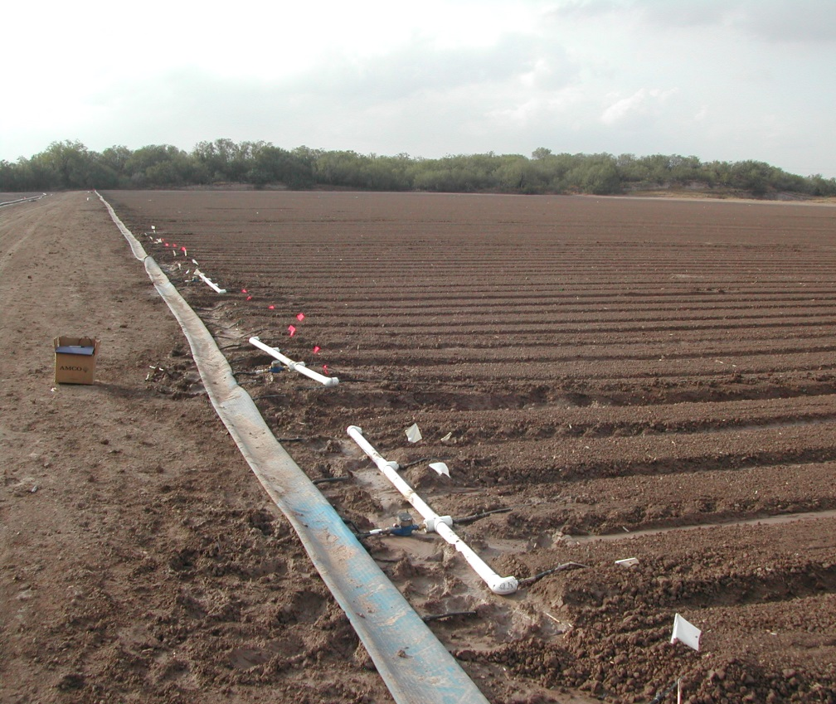
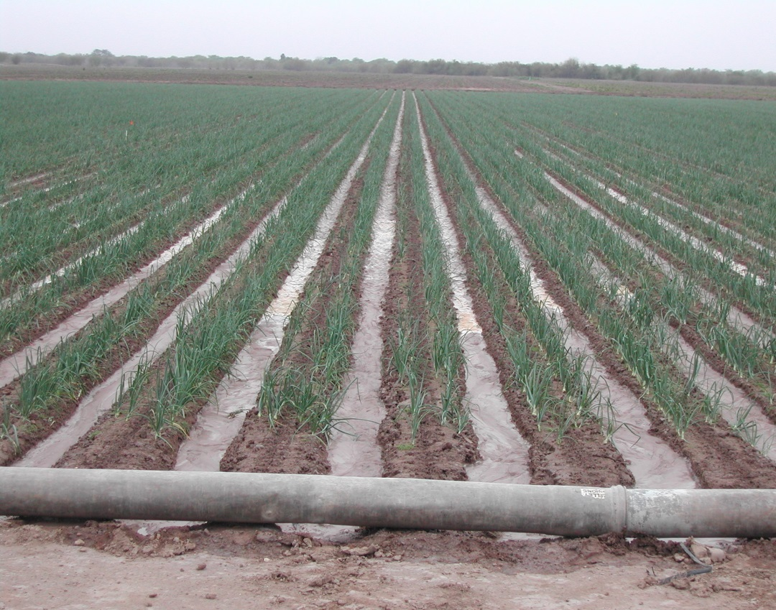
Irrigation Efficiencies Drip and Furrow
Furrow = 26.7 in or 796 lbs/in
= 25,565 lbs/ac
Drip = 14.1 in or 1,927 lbs/in
= 25,565 lbs/ac
Drip: 89 % less water and 47% more yield
Notes:
We wanted to work with commercial growers and conduct a similar experiment in a commercial field and at the research station. We wanted to evaluate were production and water used with SDI and furrow irrigation.

Slide 21
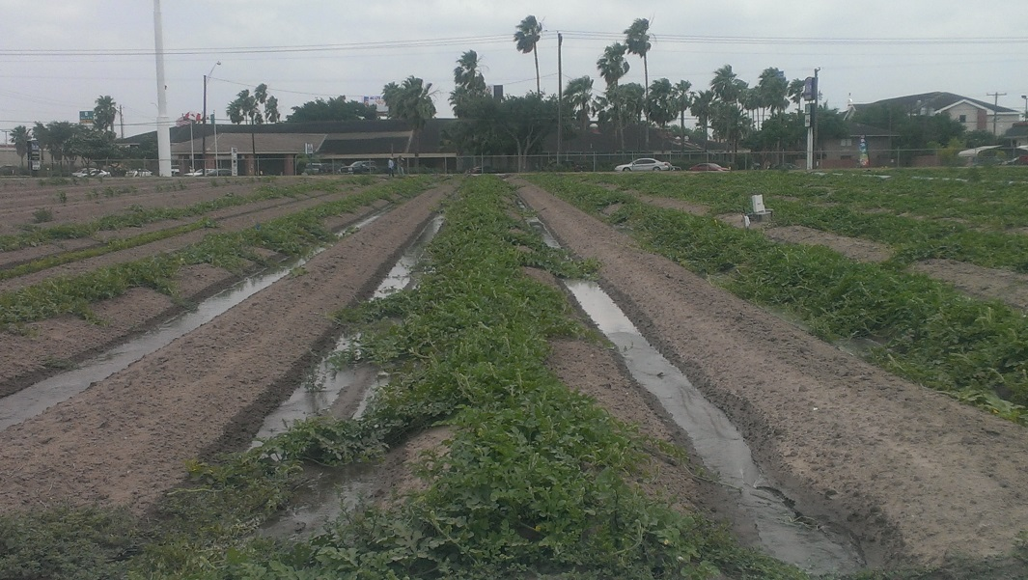
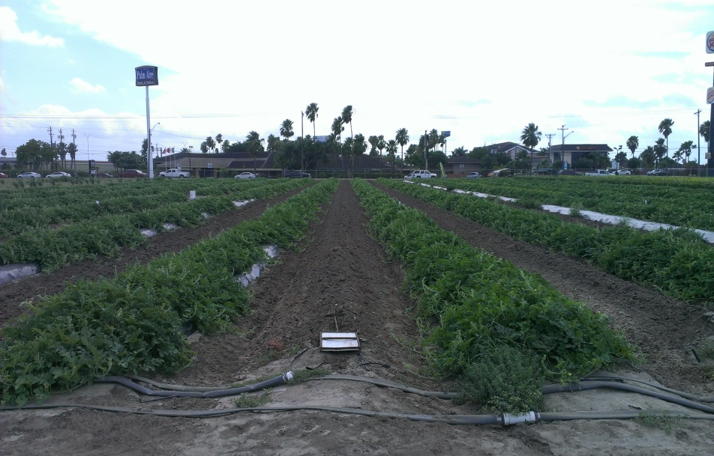
Watermelon Irrigation Study
Average in the region = 50,000 lbs/ac
http://www.legacygrowers.com/production.html
Notes:
SDI onion yields were nearly double furrow yields and triple dry-land yields.
Piruvic acid in an indicator of onion pungency or how hot it is.
Sweet onions should have low pungency. In south Texas we grow mainly short day sweet onions with pungencies levels of the range less than 3.5.

Slide 22
Acknowledgements
Texas International Produce Association
Agricultural Demonstration Initiative-TWDB
USDA-NRCS Conservation Innovation grants
USDA-NIFA Water Porfolio

