Slide 1
Texas Water Resources Institute
Victor Gutierrez
Extension Assistant
TWRI
Victor.Gutierrez@ag.tamu.edu
956-969-5611
Notes:
Been coordinating implementation of the Arroyo Colorado WPP since 2007

Slide 2
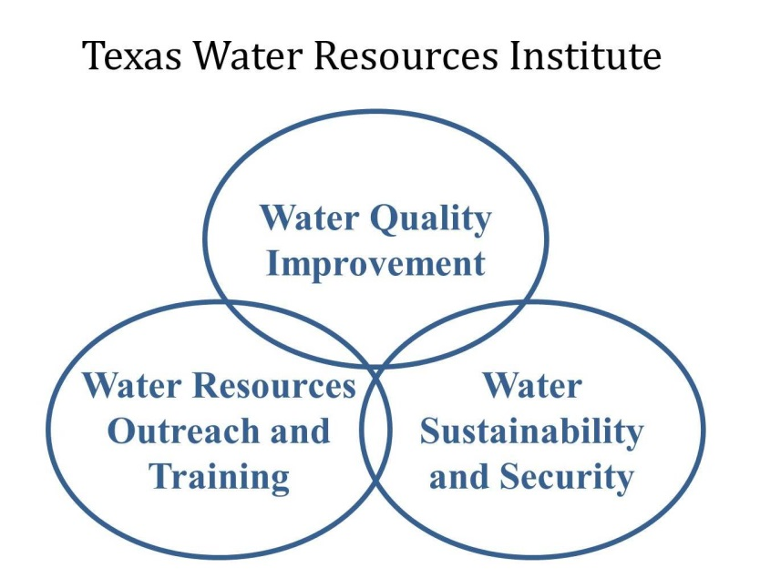
Texas Water Resources Institute
Operating unit of:
Texas A&M AgriLife Research
Texas A&M AgriLife Extension Service
Texas A&M University College of Agriculture and Life Sciences
Established by TX Legislature & Governor in 1964
To aid in the resolution of State and regional water resource issues
Notes:
Been coordinating implementation of the Arroyo Colorado WPP since 2007

Slide 3
What is RCPP?
Regional Conservation Partnership Program
Created by 2014 Farm Bill
Administered by USDA Natural Resources Conservation Service (NRCS)
Voluntary conservation effort
Promotes partnership with NRCS to address priority natural resource concerns
Provides financial & technical assistance to landowners to install/maintain conservation practices
Notes:
Area was selected due to its ecological and economic importance, the severity of its water supply and quality issues, and the existence of long-standing partnerships and efforts
supports an abundance of neotropical wildlife
ecotourism as well as saltwater fishing are important economically
Arroyo Colorado and Rio Grande have been identified as a “NPS Priority Watersheds” in the 2012 Texas Nonpoint Source Management Program
According to the 2012 Texas Water Plan, significant unmet irrigation needs are expected in the future if significant improvements in water district conveyance systems and on-farm conservation practices are not achieved

Slide 4
What is RCPP?
In 2014-2015, $235M available nationally
Funding allocated as follows:
35% Critical Conservation Areas (e.g. Chesapeake)
40% National/Multi-State Projects
25% Single State Projects
TWRI submitted pre-proposal – July 2014
TWRI submitted full proposal – October 2014
Agreement initiated – June 2015
Notes:
Area was selected due to its ecological and economic importance, the severity of its water supply and quality issues, and the existence of long-standing partnerships and efforts
supports an abundance of neotropical wildlife
ecotourism as well as saltwater fishing are important economically
Arroyo Colorado and Rio Grande have been identified as a “NPS Priority Watersheds” in the 2012 Texas Nonpoint Source Management Program
According to the 2012 Texas Water Plan, significant unmet irrigation needs are expected in the future if significant improvements in water district conveyance systems and on-farm conservation practices are not achieved

Slide 5
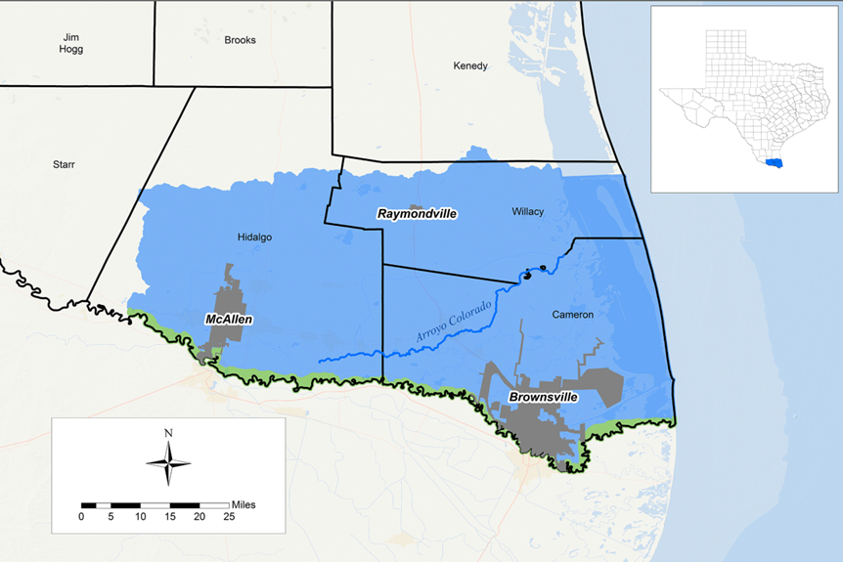
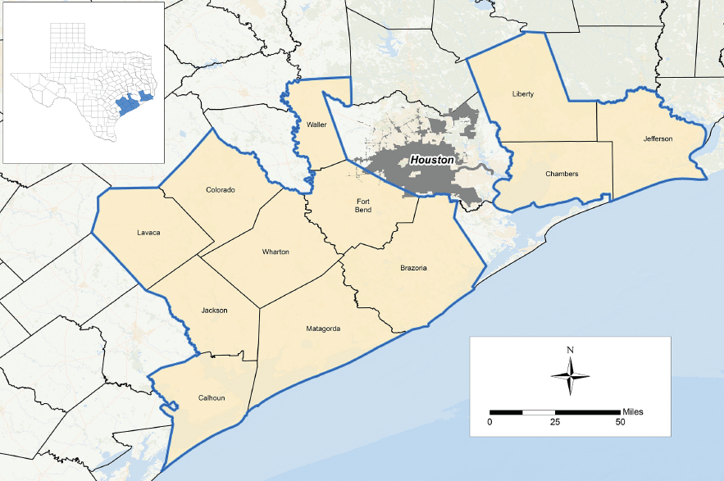
2014-2015 Texas RCPP Projects
Lower Rio Grande Valley Water Improvement Initiative
Rice Stewardship Partnership
Texas Gulf Coast Stream & Wetland Initiative

Slide 6
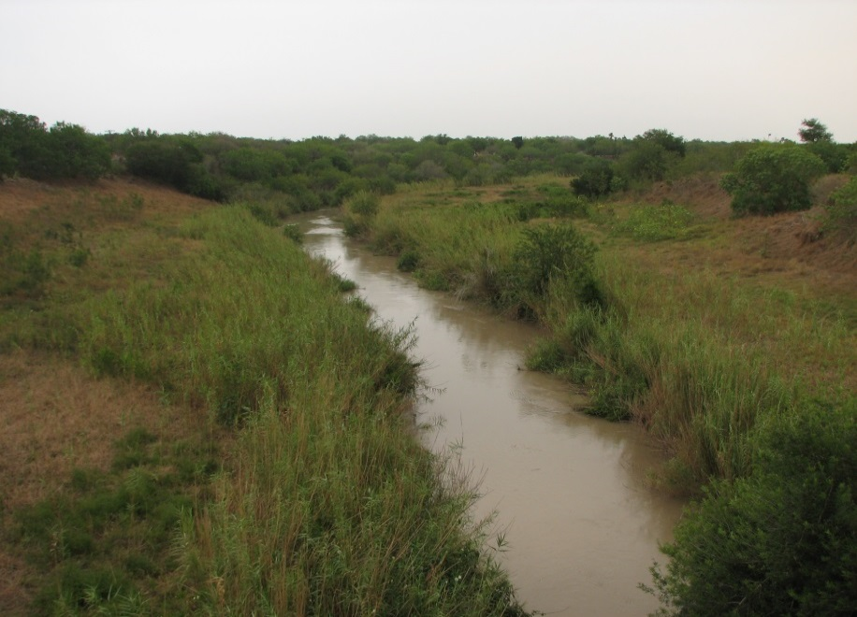
Goals
Enhance agricultural water use efficiency
Improve irrigation scheduling
Enhance irrigation delivery
Increased adoption of improved irrigation technologies (conventional & innovative)

Slide 7
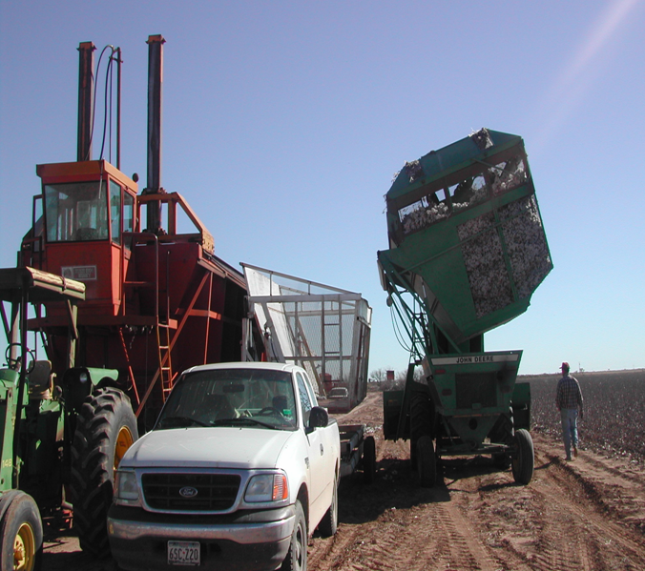
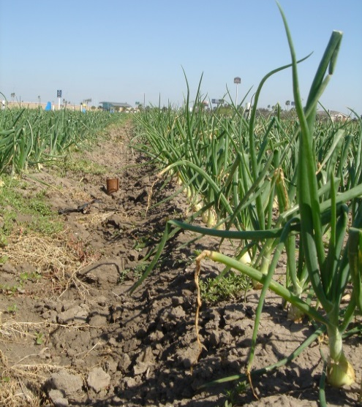
Goals
Improve water quality
Reduce irrigation return flows
Better manage nutrients
Decrease runoff & loss of soil & nutrients
Maintain/increase ag productivity/profitability

Slide 8
Objectives
Provide technical and financial assistance to ag producers to improve nutrient & irrigation management
Enhance adoption nutrient & irrigation water management through evaluation, demonstration, and education programs
Monitor/report progress & results

Slide 9
Key Conservation Practices
Resource Concern | Objectives | Specific Conservation Practices
Water Quantity (National and State Resource Concern) | Increase irrigation water use efficiency | Pond (378) Irrigation Water Conveyance (428) Irrigation Pipeline (430) Irrigation Reservoir (436) Irrigation System (441-443) Irrigation Water Management (449) Precision Land Forming (462) Irrigation Land Leveling (464) Irrigation Canal or Lateral (320) Irrigation Field Ditch (388)
Water Quality (National and State Resource Concern) | Reduce nutrients loadings to waterbodies Reduce bacterial loadings to waterbodies Increase dissolved oxygen Reduce sediment entering waterbodies | Conservation Crop Rotation (328) Residue Management (329, 344, 345, 346) Cover Crop (340) Filter Strip (393) Grade Stabilization Structures (410) Irrigation Pipeline (430) Irrigation System (441-443) Irrigation Tailwater Recovery (447) Irrigation Water Management (449) Irrigation Land Leveling (464) Forage and Biomass Planting (512) Nutrient Management (590) Subsurface Drain (606) Constructed Wetland (656) Wetland Restoration (657) Wetland Creation (658) Wetland Enhancement (659)

Slide 10
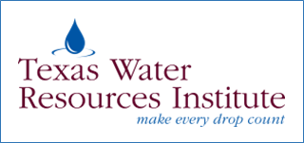
Conservation Reserve Program: Clean Lakes, Estuaries and Rivers (CLEAR) - Bioreactors and Saturated Buffers
CRP participants establish long-term, resource-conserving vegetative species, such as approved grasses or trees (known as “covers”) to control soil erosion, improve the water quality and enhance wildlife habitat. In return, FSA provides participants with rental payments and cost-share assistance. Contracts are 10 to 15 years in duration.
Through CLEAR, FSA is targeting existing Filter Strip (CP21) and Riparian Buffer (CP22) practices that are already enrolled in CRP or are part of a new enrollment offer in areas with a need to reduce nitrate loading to surface water from subsurface drain outlets.

Slide 11
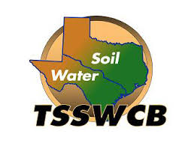
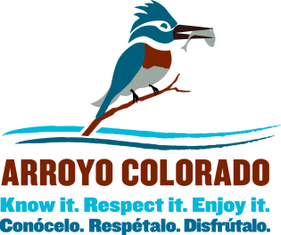
Thanks To Our Partners
Cameron County Irrigation District #2

